Slide 1
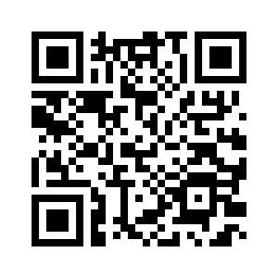
Language selection
https://tinyurl.com/y3jkklth

Slide 2
TDD
Getting a Grip

Slide 3
Let’s start the implementation...
Where should I start from?
With a test!

Slide 4
Let’s start the implementation...
Enforces you to put yourself into the user’s shoes.
Helps to be focus on Software that works.
Reduces the amount of code created.
Early feedback.

Slide 5
Taking care of the ways...
Andoni Arroyo Software Developer
andoni@andoniarroyo.com https://www.andoniarroyo.com All the opinions are my own :)

Slide 6
TDD - Overview
Test driven Development is a software development process that relies on the repetition of a very short development cycle. (red, green, refactor cycle)
Test-First development (XP).
The tests are a side effect.
TDD does not make the design decisions. Developer does.
Notes:
Tests in TDD
not for the purpose of testing itself but more for the purpose of driving the design.
API documentation
designing ‘assistants’
TDD is not only about unit testing
TDD is an attitude as well as a discipline

Slide 7

It is about money
Notes:
Realizing quality improvement through test driven development: results and experiences of four industrial teams. Empirical Software Engineering, Vol. 13:3, 289–302.

Slide 8
It is about money
*Realizing quality improvement through test driven development: results and experiences of four industrial teams. Empirical Software Engineering, Vol. 13:3, 289–302.
 | IBM (drivers) | MS (Windows) | MS (MSN) | MS (VS)
Increase in time | 15-20% | 25-35% | 15% | 20-25%
Defects reduction | 49% | 62% | 76% | 99.1%

Slide 9


Slide 10
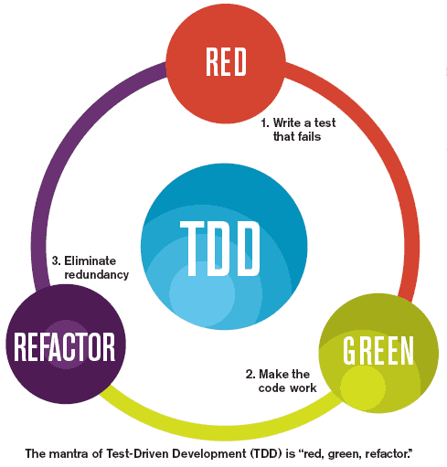
The TDD development cycle

Slide 11
Step 1 – Red
Write a test focus on a new capability of your software.
It should fail...but sometimes it doesn't fail.
Just a test than is sufficient to fail and one failing test.
Notes:
The test is wrong (2 ways check). The functionality that is already implemented.

Slide 12
Step 2 – Green
Write production code.
Only enough code that is sufficient for the test to pass. (Fake It).

Slide 13
Step 3 – Refactor
Clean up after yourself.
Improve the design of your code (tests and implementation).
Never add new functionality.
Notes:
If you broke something, revert all the changes that you did during the refactoring.

Slide 14
Three laws of TDD
You may not write production code unless you’ve first written a failing test.
You may not write more of a test than is sufficient to fail.
You may not write more production code than is sufficient to make the failing test pass.
Few minutes to iterate.

Slide 15

Time to play
“I hear, and I forget, I see, and I remember, I do, and I understand” Wifi: thehive / u7g8cX3F7a3828R949k86
Exercise 1
https://github.com/andoniarroyo/TDD-workshop-Exercise1
Exercise 2
https://github.com/andoniarroyo/TDD-workshop-Exercise2

Slide 16
TDD always?
TDD is good for cases where you have very clear input and very clear output but in real work that is not always the case.
The closer you are to your domain the better ROI gives you back TDD
TDD is a tool that does not have to be used for all tasks, should be put into awareness.

Slide 17
Pros/cons about TDD
Pros
Better design (Reducing zombie code).
Minimal debugging.
Really nice side effect: create a good bunch of tests (Regression).
Is a way of managing fear during programming (zoom in - zoom out).
Cons
Counterintuitive (Ignaz Semmelweis in his maternity ward).
Increase time taken to code.
Notes:
focus on what you want before you know how to do it (benefit - as a...)
High code coverage (reducing the fear of changing)
helps to avoid ‘analysis – paralysis’
TDD approach is more efficient than conventional approach
less complex modules, classes and meth- ods because they are usually smaller
There is no design in TDD
There is related misconception that a great design (architecture) will magically appear just from the tests. That is, naturally, not true.
TDD wastes developers’ time
dogmatism of some of its proponents.
TDD isn’t a silver bullet and won’t suddenly transform you into a sterling professional.

Slide 18
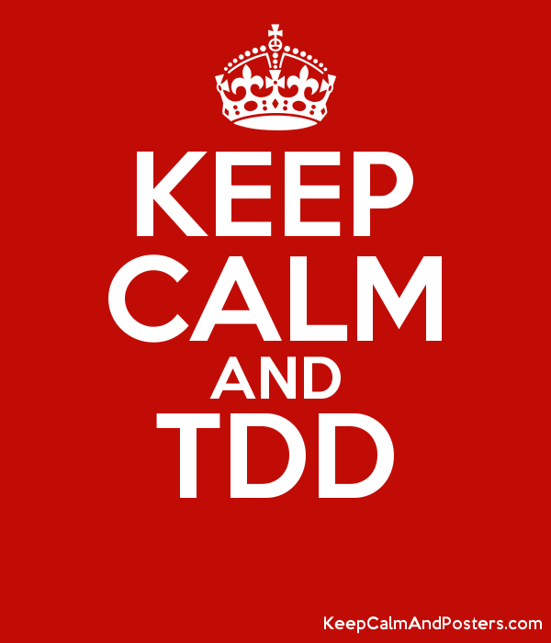
Thanks!
Andoni Arroyo Software Developer
andoni@andoniarroyo.com https://www.andoniarroyo.com

